Slide 1
Disk Management

Slide 2
Mass-Storage Structure
Magnetic Disks
Relatively simple
Disk platter has a flat circular shape
Platter diameter can be between 1.8 to 5.25 inches
Surfaces are covered with magnetic material
Stores information by recording it magnetically on the platters

Slide 3
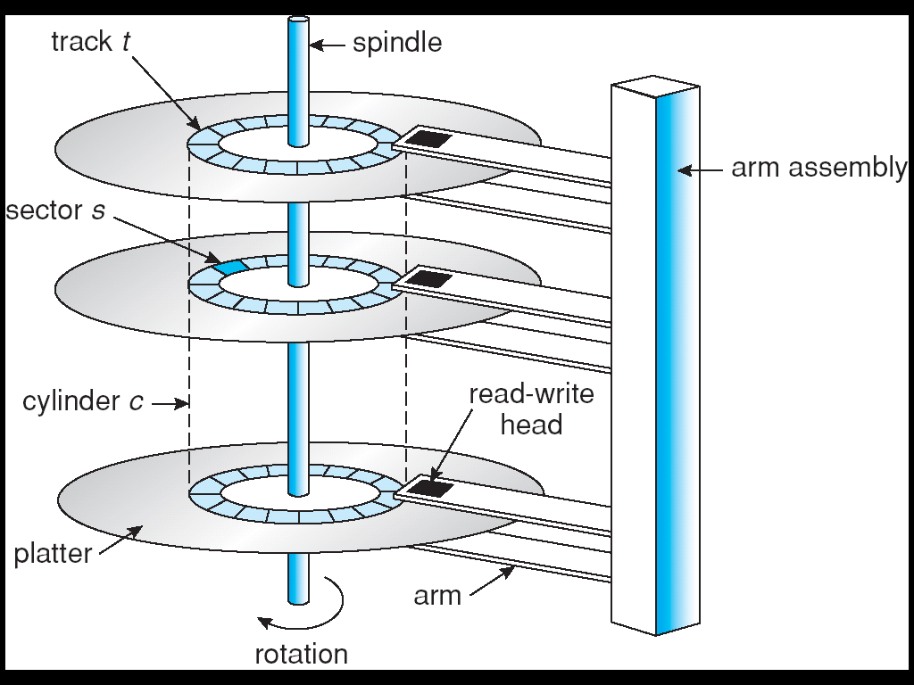
Moving-head Disk Mechanism

Slide 4
Mass-Storage Structure
Magnetic Tapes
Early Storage Mechanism
Is relatively permanent and can hold large quantities of data
Access Time is slow compared with that of main memory and magnetic disks
Random access to magnetic tapes are very slower than random access to magnetic disks
Not very useful for secondary storage
Mainly used for backup, infrequently used data, or as a medium of data transfer
Storage – typically, 20 GB to 200 GB

Slide 5
Disk Attachment
Computers access disk storage in two ways:
Via Input-Output Ports (host-attached storage)
Common on small systems
Examples: hard disk drives, RAID arrays, CD, DVD, tapes, etc.
Via a Remote Host in a Distributed File System (network-attached storage)
Special purpose storage system accessed over a data network
Clients access NAS via remote procedure call interface
A special case – Storage Area Network (SAN)

Slide 6
Seek Time:Seek time is the time taken to locate the disk arm to a specified track where the data is to be read or write. So the disk scheduling algorithm that gives minimum average seek time is better.
Rotational Latency: Rotational Latency is the time taken by the desired sector of disk to rotate into a position so that it can access the read/write heads. So the disk scheduling algorithm that gives minimum rotational latency is better.
Transfer Time: Transfer time is the time to transfer the data. It depends on the rotating speed of the disk and number of bytes to be transferred.

Slide 7
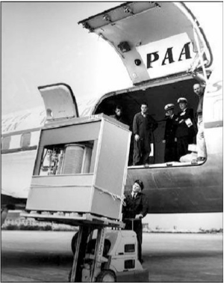
The First Commercial Disk Drive
1956
IBM RAMDAC computer included the IBM Model 350 disk storage system
5M (7 bit) characters
50 x 24” platters
Access time = < 1 second

Slide 8
Disk Scheduling
The operating system is responsible for using hardware efficiently — for the disk drives, this means having a fast access time and disk bandwidth.
Access time has two major components
Seek time is the time for the disk are to move the heads to the cylinder containing the desired sector.
Rotational latency is the additional time waiting for the disk to rotate the desired sector to the disk head.
Minimize seek time
Seek time ≈ seek distance

Slide 9
Disk Scheduling
If the desired disk drive and controller are available then the request can be served immediately
If the drive or controller is busy, any new requests for service will be placed in the queue
When one request is completed the operating system chooses which pending request to service next.
How does OS make this choice ?
Answer: Disk Scheduling Algorithms

Slide 10
Disk Scheduling Algorithms
FCFS (First Come First Served) Scheduling
SSTF (Shortest Seek Time First) Scheduling
SCAN Scheduling
C-SCAN Scheduling
LOOK Scheduling
C-LOOK Scheduling

Slide 11
FCFS(First Come First Serve)
Several algorithms exist to schedule the servicing of disk I/O requests.
We illustrate them with a request queue (0-199)
82,170,43,140,24,16,190
Head pointer 50
Calculate the total no of track movements by R/W head

Slide 12
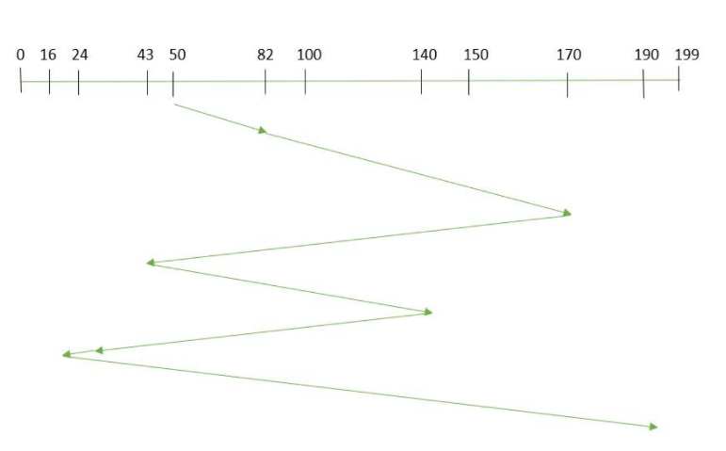
Illustration shows total head movement of 642
So, total seek time: =(82-50)+(170-82)+(170-43)+(140-43)+(140-24)+(24-16)+(190-16) =642

Slide 13
FCFS Scheduling Practice Question
Question:
A disk contains 200 tracks (0-199). Request queue contains track numbers 98, 183, 37, 122, 14, 124, 65, 67respectively. Assume that the current position of the read-write head is at 53. Calculate the total number of track movements by the read-write head using FCFS Scheduling Algorithm.

Slide 14
SSTF
Selects the request with the minimum seek time from the current head position.
SSTF scheduling is a form of SJF scheduling; may cause starvation of some requests.

Slide 15
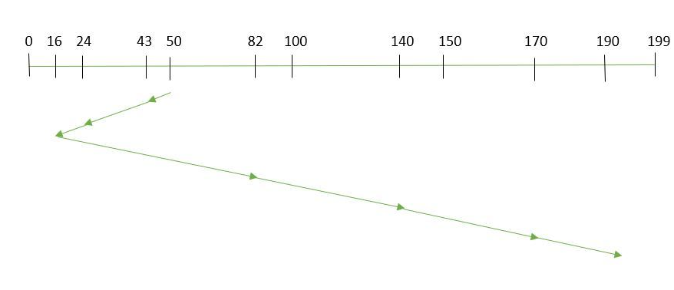
A disk contains 200 tracks
Request queue contains
82,170,43,140,24,16,190
Head pointer is at 50
(50-43)+(43-24)+(24-16)+(82-16)+(40-82)+(170-140)+(190-170)=208
Illustration shows total head movement of 208

Slide 16
SSTF
A disk contains 200 tracks (0-199). Request queue contains track numbers 98, 183, 37, 122, 14, 124, 65, 67respectively. Assume that the current position of the read-write head is at 53. Calculate the total number of track movements by the read-write head using SSTF Scheduling Algorithm

Slide 17
SCAN
The disk arm starts at one end of the disk, and moves toward the other end, servicing requests until it gets to the other end of the disk, where the head movement is reversed and servicing continues.
Sometimes called the elevator algorithm.
Illustration shows total head movement of cylinders.

Slide 18
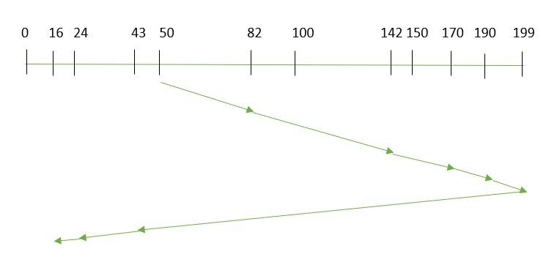
SCAN
A disk contains 200 tracks
Request queue contains
82,170,43,140,24,16,190
Head pointer is at 50
=(199-50)+(199-16) = 332

Slide 19
SCAN
A disk contains 200 tracks (0-199). Request queue contains track numbers 98, 183, 37, 122, 14, 124, 65, 67respectively. Assume that the current position of the read-write head is at 53. Calculate the total number of track movements by the read-write head using Scan Scheduling Algorithm

Slide 20
C-SCAN
Provides a more uniform wait time than SCAN.
The head moves from one end of the disk to the other. servicing requests as it goes. When it reaches the other end, however, it immediately returns to the beginning of the disk, without servicing any requests on the return trip.
Treats the cylinders as a circular list that wraps around from the last cylinder to the first one.

Slide 21
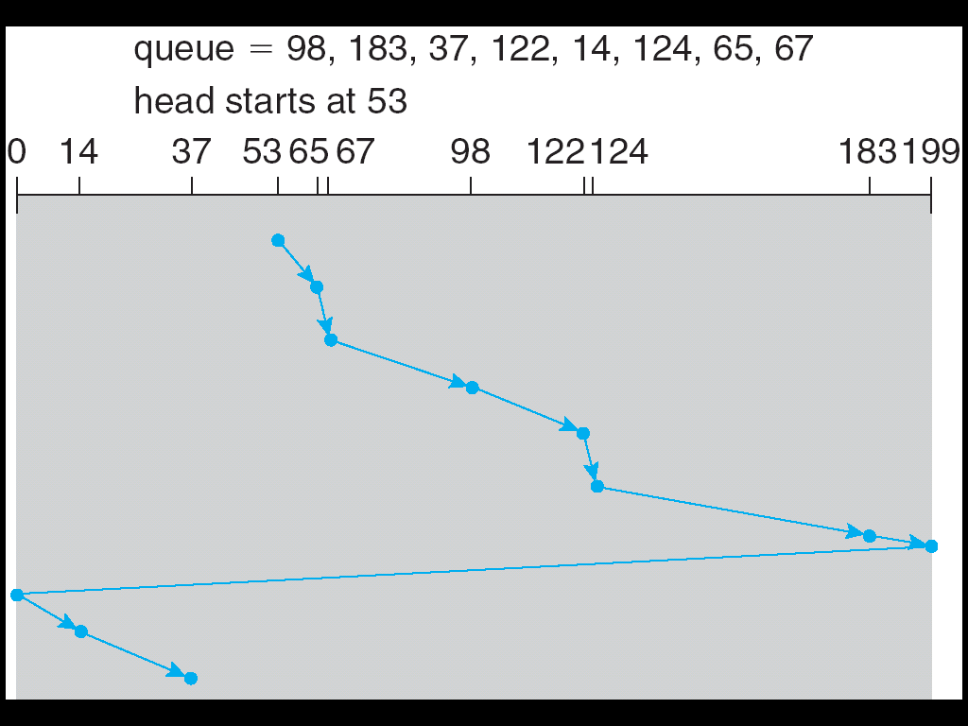
C-SCAN (Cont.)

Slide 22
LOOK
It is similar to the SCAN disk scheduling algorithm except for the difference that the disk arm in spite of going to the end of the disk goes only to the last request to be serviced in front of the head and then reverses its direction from there only.
Thus it prevents the extra delay which occurred due to unnecessary traversal to the end of the disk.
Request queue -82,170,43,140,24,16,190.
Read/Write arm is at 50, and it is also given that the disk arm should move “towards the larger value”.

Slide 23
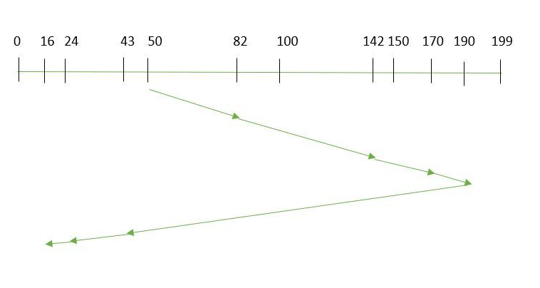
LOOK
=(199-50)+(199-16) = 314

Slide 24
C-LOOK
Version of C-SCAN
Arm only goes as far as the last request in each direction, then reverses direction immediately, without first going all the way to the end of the disk.

Slide 25
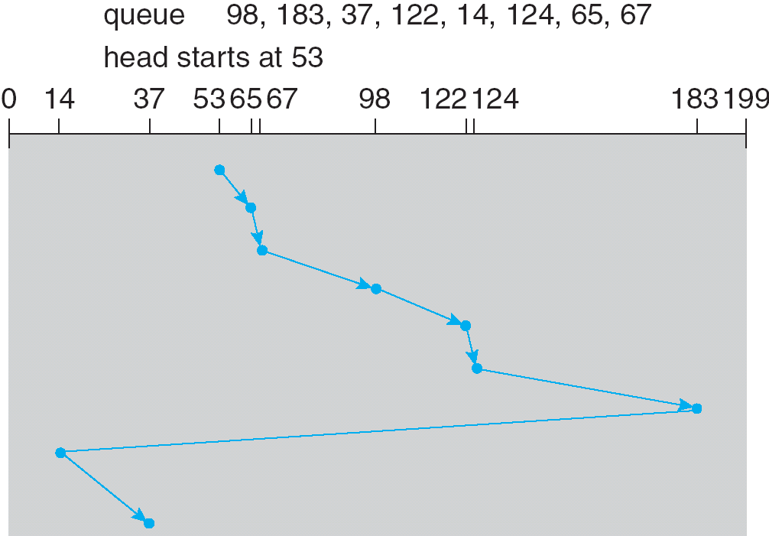
C-LOOK (Cont.)

Slide 26
Selecting a Disk-Scheduling Algorithm
SSTF is common and has a natural appeal
SCAN and C-SCAN perform better for systems that place a heavy load on the disk.
Performance depends on the number and types of requests.
Requests for disk service can be influenced by the file-allocation method.
The disk-scheduling algorithm should be written as a separate module of the operating system, allowing it to be replaced with a different algorithm if necessary.
Either SSTF or LOOK is a reasonable choice for the default algorithm.

